Slide 1
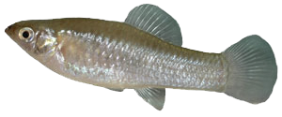
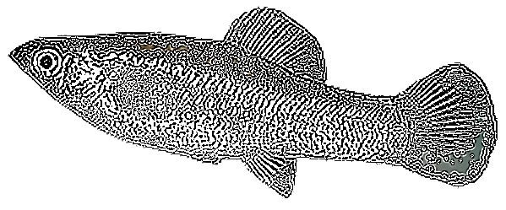

Original Photo
High contrast / line picture
Steps:
1) Get image without background
2) Control-C image (copy)
3) Paste using right click (does not work properly with Control-V
no clue why – its gets fixed in previous contrast instead of resetting)
4) Click new image ->
You can even Andy-Warhole
the whole thing

Slide 2

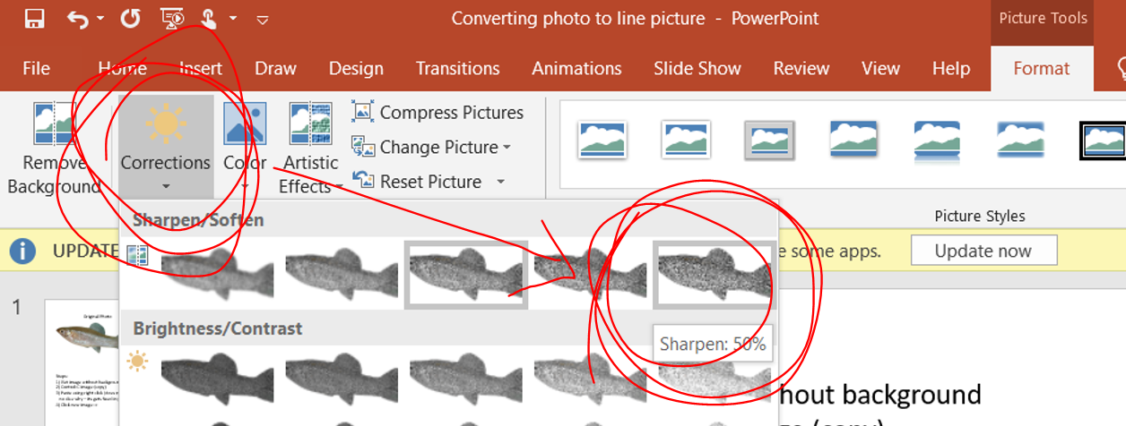
Steps:
1) Get image without background
2) Control-C image (copy)
3) Paste using right click (does not work properly with Control-V
no clue why – its gets fixed in previous contrast instead of resetting)
4) Click new image -> Go to Format
5) Click ‘Corrections’ and then in the tab for ‘Sharpen/Soften’
Click the bock farthest to the right ‘Sharpen 50%’
6) Go to step 2 and repeat …. Many times (Example below) – for this image it took me 20 times

Slide 3
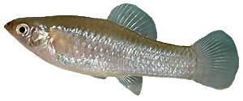
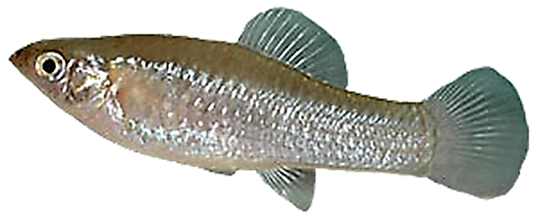
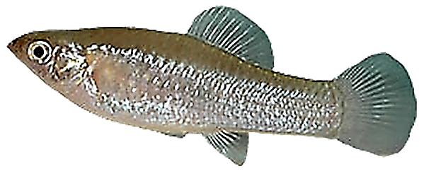
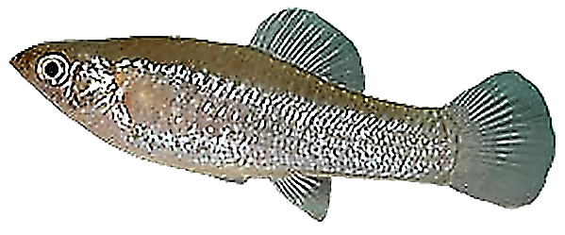
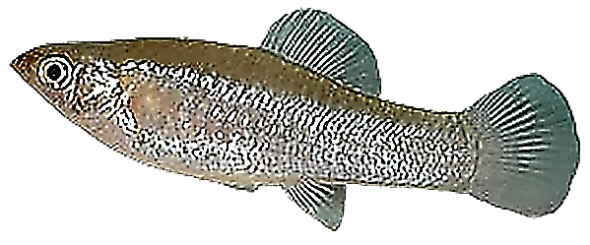

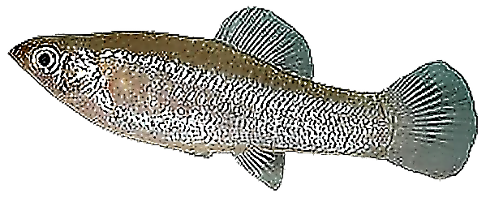

Slide 4
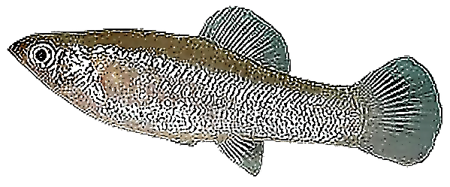


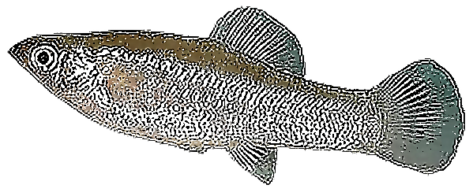


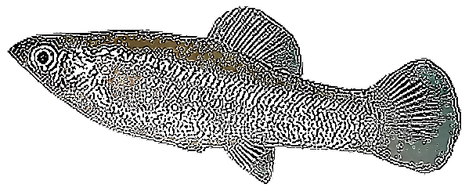
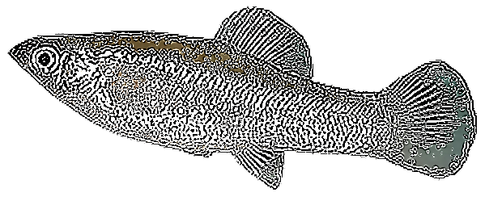

Slide 5
